Slide 1
MODULE V : TEAM
Teams: Advantages of Teams, Model of Team Effectiveness, Stages of Team Development.
Power : Meaning, Sources, and Contingencies of Power, Consequences of Power.

Slide 2
TEAM
It is a group of individuals who work together towards a common goal. Effective teams leverage the unique skills and perspectives of each member to accomplish tasks more efficiently.
Teams can bring together a variety of expertise, fostering creativity and innovation.
Characteristics of Effective Teams :
1. Clear Goals.
2. Complementary Skills.
3. Mutual Accountability.
4. Open Communication.

Slide 3
Models of Team Effectiveness
Teams are groups of two or more people who interact and influence each other, are mutually accountable for achieving common goals associated with organizational objectives, and perceive themselves as a social entity within an organization.
A team is effective when it benefits the organization, its members, and its own survival. So effectiveness is partly measured by the achieve ment of the objectives and partly by the satisfaction and well-being of its members.

Slide 4
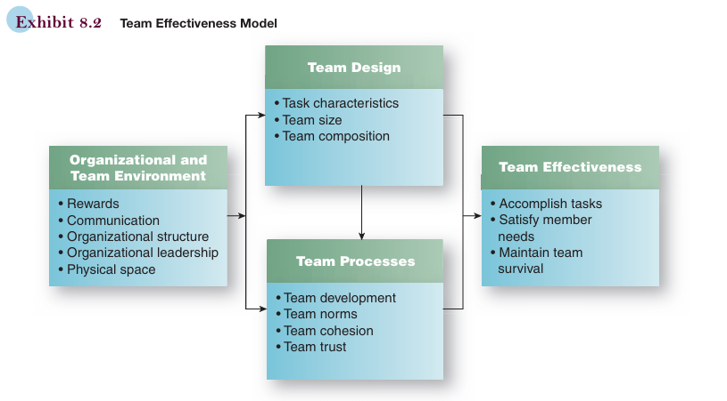
Team Effectiveness

Slide 5
Advantages of Teams
Increases Productivity.
Increases Motivation and Encouragement.
Provides more learning opportunities.
Better Communication.
Teams Resolve Problems Quicker.
Creativity.

Slide 6
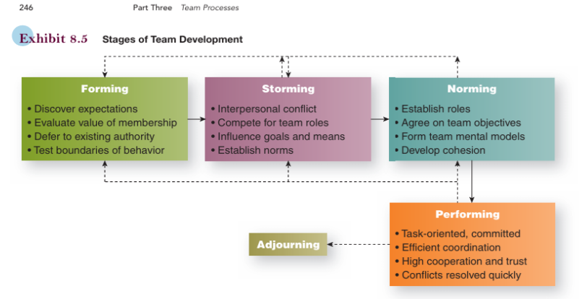
Stages of Team Development

